Slide 1

INTRODUCTION
TO
HADOOP AND ITS ECOSYSTEM

Slide 2
HADOOP
Apache Hadoop is framework for running applications on large cluster built of commodity hardware.
A reliable shared storage and analysis system.
A framework for Map Reduce.
A top level Apache Project.
“Flexible and available architecture for large scale computation and data processing on a network of commodity hardware ”.
Open source Software + Hardware commodity =IT costs solution

Slide 3
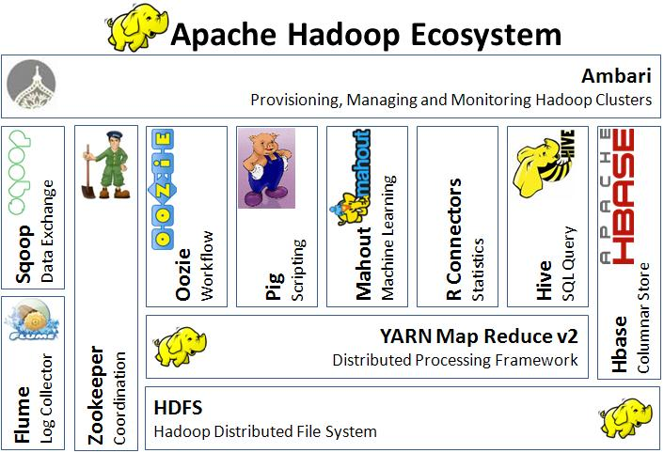
Hadoop Ecosystem
Hadoop ecosystem can be described as a data centric taxonomy to analyze, aggregate, store and report data.
The various components of Hadoop ecosystem are:
HDFS
Hive
Pig
YARN
Flume
Sqoop
Oozie
Zookeeper
Mahout
Ambari

Slide 4
1.HDFS :
HDFS stands for Hadoop Distributed File System for managing big data sets with High Volume, Velocity and Variety. HDFS implements master slave architecture. Master is Name node and slave is data node.
Features are Scalable , Reliable , Commodity Hardware
HDFS is the well known for Big Data storage.
2. HIVE:
Apache Hive is another high level query language and data warehouse infrastructure built on top of Hadoop for providing data summarization, query and analysis. It is initially developed by yahoo and made open source.
SQL like query language called HQL.
Partitioning and bucketing for faster data processing.
3. PIG :
Apache Pig is a high level language built on top of MapReduce for analyzing large datasets with simple adhoc data analysis programs.
Pig is also known as Data Flow language. It is very well integrated with python.
It is initially developed by yahoo.

Slide 5
4. YARN :
YARN stands for Yet Another Resource Negotiator. It is also called as Map Reduce 2(MRv2).
The two major functionalities of Job Tracker in MRv1, resource management and job scheduling/ monitoring are split into separate daemons which are Resource Manager, Node Manager and Application Master.
5. FLUME :
Flume is a distributed, reliable, and available service for efficiently collecting, aggregating, and moving large amounts of log data.
6. SQOOP :
Apache Sqoop is a tool designed for bulk data transfers between relational databases and Hadoop.
7.OOZIE :
Oozie is a workflow scheduler system to manage Apache Hadoop jobs.
Scalable, reliable and extensible system.
Supports several types of Hadoop jobs such as Map-Reduce, Hive, Pig and Sqoop.

Slide 6
8. ZOOKEEPER :
Zookeeper is a centralized service designed for maintaining configuration information, naming, providing distributed synchronization, and providing group services.
Features are : Serialization, Atomicity, Reliability and Simple API.
9. MAHOUT :
Apache Mahout is a scalable machine learning library designed for building predictive analytics on Big Data.
Mahout now has implementations apache spark for faster in memory computing.
10. AMBARI :
Ambari is designed to make hadoop management simpler by providing an interface for provisioning, managing and monitoring Apache Hadoop Clusters.

